Slide 1


Slide 2


Home care
IN CZECH REPUBLIC

Slide 3

Working experience in home care for students
Our school – Students don't have a working experience in home care.
Options :
  Part-time job
  Volunteering activity (according to competences and under professional supervision)

Slide 4
Organizing of home care
Home care is indicated by:
  Doctor at hospital – (for 14 days)
  General practitioner – (for unlimited period of time)
Care service – Can be ordered by the patient at GP, but is covered by the insurance company.
Provided by caregivers – they only need a nursing course (help with basic care and household)
Financing of home care:
  General care indicated by a doctor – fully paid by the insurance company
  Special equipments –is partly covered by the insurance company
Targets of home care – patients with chronic diseases, patients with disabilities, patients in the final stage of life, families with children, whose situation requires the help of another person...

Slide 5
The job description of a nurse in home care
Nursing service – from 6:00 to 22:00 every day, including the weekend and public holidays
Home health care can also be provided 24 hours a day in exceptional cases(care for dying patient, etc.)
Average visits – 20 patients per day
Nurses use a company car
Nurse plans the daily schedule according to: the address of the patient, type and difficulty of the treatment. Then, they write a report about it.
Nurse's operations: injections, medicine application, infusion application, catheterization, wound re-bandage, practice of insulin application...

Slide 6
The job description of a caregiver
Basic social counseling
Help with routine actions of care
Help with personal hygiene
Meal preparation
Food delivery
Help to keep the household running (cleaning, maintenance)
Water delivery
Laundry and ironing
Escort to school, to doctors...
Regular or big groceries
Legwork
Supervision of medication intake
Escort for a walk

Slide 7


Training, education and wages
Caregivers - at least a basic education and nursing course (3months)
Nurses working in home care – general nurses in the field of community nursing care (Bc.) + 24 hours of training annually
Average salary of nurse in a hospital - 43 000 Czech crowns (1 770€)
Average salary of a nurse in home health care - 35 000 Czech crowns (1 440€)
Average salary of a caregiver - 18 100 Czech crowns (750€)

Slide 8

Food care
Lunch delivery – 50 patients per day (10 minutes/delivery)– 40 Czech crowns per operation (1.70€)
Help with food and drink preparation – 10 patients/day (30 minutes/operation) - 135 Czech crowns (5.70€)
All these services are performed by a caregiver.

Slide 9
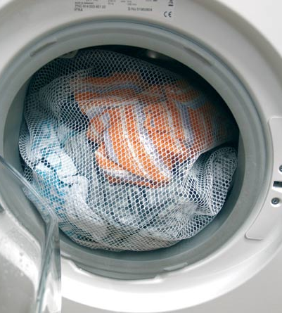
Laundry care
Laundry and ironing – 1 hour/1 washing machine; 70 Czech crowns (3€) per 1kg of laundry
Ironing (without laundry) - 35 Czech crowns (1.50€) per 1kg
All these services are performed by a caregiver.
Tato fotka od autora Neznámý autor s licencí CC BY-SA-NC

Slide 10

Links with the family
Helping the family consists of helping, when the family is away for work, doctor´s visit, etc.
Sometimes the worker can only train the patient's family and they continue to care for the patient themselves without the need for a care service.

Slide 11
Thank you for your attention!
Created by: Kateřina Klimešová, Matouš Čálek, Nela Fidlerová, Markéta Janáková and Kateřina Kážová
(The information used is based on The Nursing Service Dvůr Králové nad Labem, details in other services may differ.)

