Slide 1


Slide 2


MEDICATION ADMINISTRATION RULES
Questions and answers

Slide 3
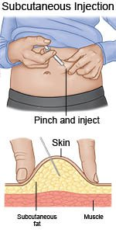
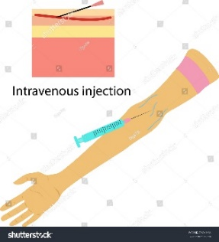

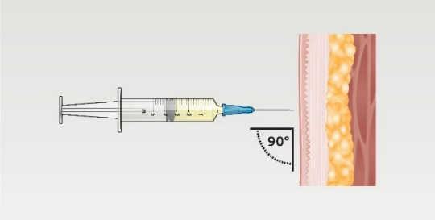
Who is responsible for the administration of medication?
In the Czech Republic only doctors and nurses can administer medication
Only doctors can prescribe medication
Students can administer medication only under teacher‘s or nurse‘s supervision
Nurses can administer medication:
Subcutaneous injection
Intravenous injection
Per os
Intramuscular injection

Slide 4


What kind of education do these people need?
Doctor 6 years - Faculty of Medicine
3-4 years - experience + atestation
Practice Nurse 4 years - nursing school (incl. graduation)
only limited permission
Graduate Nurse 3 years - Higher vocational school (incl. absolutorium)
general/specialized

Slide 5


How many people is necessary for the preparation and the administration of medication?
In Czechia only 1 nurse is required for the preparation and the administration of medication.
Here no witness is required. The nurse is responsible, she can be tracked in case of a mistake.
Students can administer medication only under teacher's or nurse's supervision

Slide 6
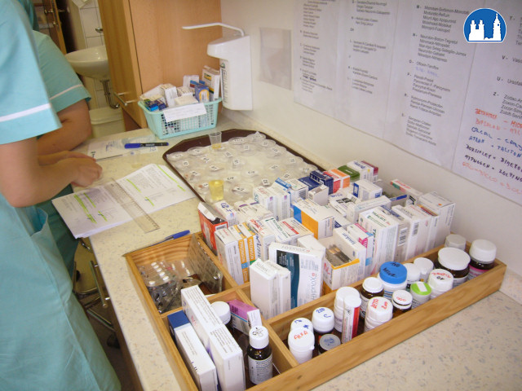

Can a night shift nurse prepare medication and then a day shift nurse administers it to the patients?
In our country, one nurse has to prepare the medication and immediately administers it to patients.

Slide 7
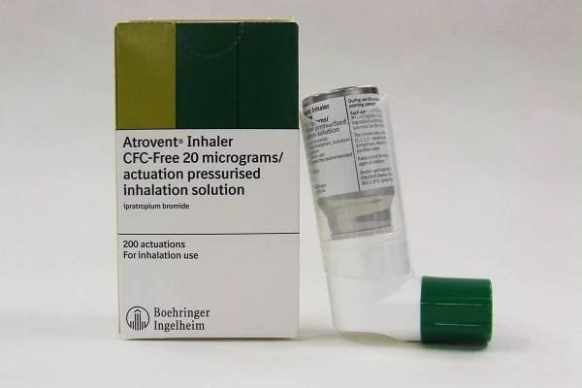

Can nurses administer patient‘s own medication in hospital?
The patient can bring medicines prescribed by his doctor from home.
Upon admission the patient hands over the medication, the nurse concults it with the doctor.
The patient is not allowed to use any medicine on his own.

Slide 8
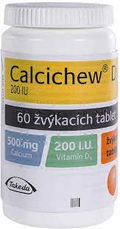

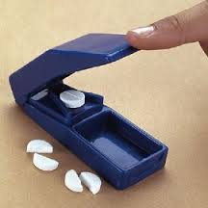
If the nurse cuts a tablet and administers only a half, can she return the other half to the original container?
We can return the other half only to the pill bottles.
We can not return it to the medicine bill, due to the risk of medication confusion.

Slide 9

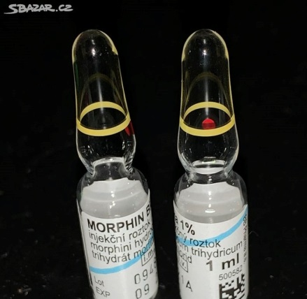
What are the rules while administering narcotic and storage of narcotics?
Narcotics are locked in a special safe.
We have the book in which we have to note:
  Date
  Name of narcotic
  Number of pills taken and left
  patient‘s name
  Signature and stamp of the administrator

Slide 10

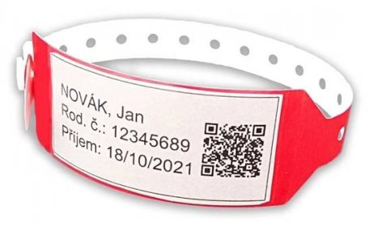
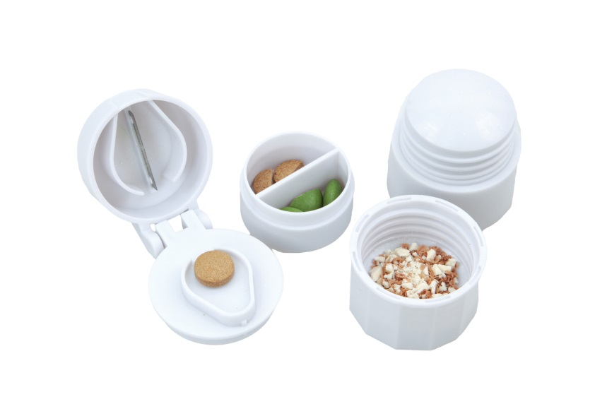

What are common mistakes while administering medication and why do these slip-ups happen?
Wrong identification
More people with identical last name
Mistaken dosage
Similar medication names

Slide 11
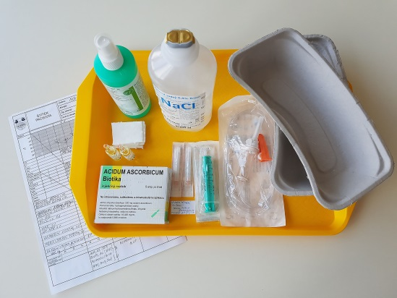
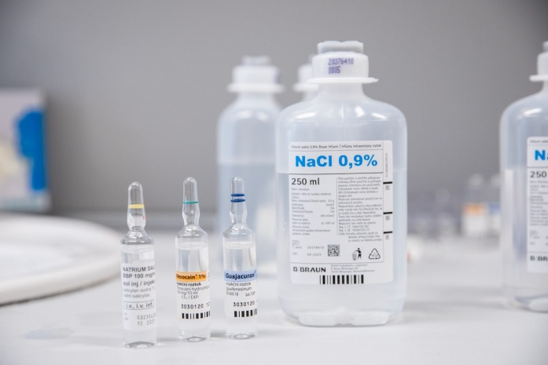
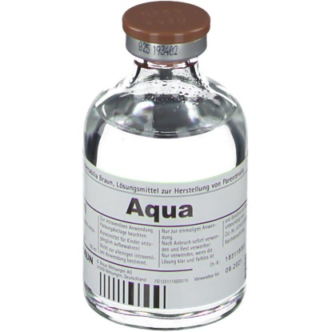
Process during medicine application
Infusion application
  Patient's card stating the medication
  Medicine and accesories preparation
  Medicine check before preparation
  Medicine preparation
  Patient's check before administration
  Medicine administration (prescription needed)
  Data recording (signature, stamp)

Slide 12
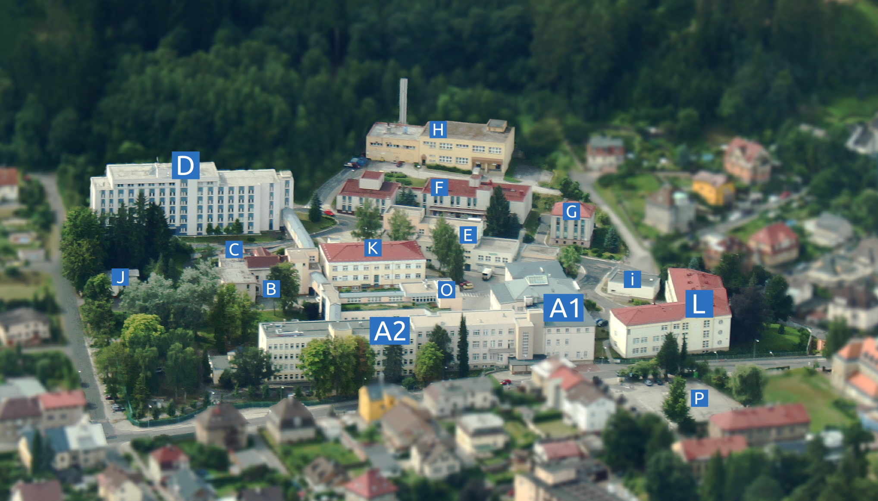
THANK YOU FOR YOUR ATTENTION
Trutnov Regional Hospital

