Slide 1


Slide 2

Language competence of student nurses

Slide 3

Which foreign language do they study?
In France, only English is taught to students in the professional bac Accompaniment and care of the person

Slide 4
Can they choose the language?
The Lycee Lumiere in luxeuil les bains offers no other choice

Slide 5
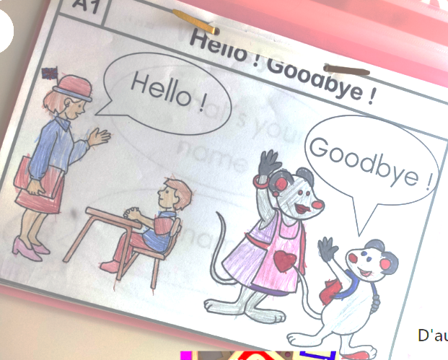
At what age do they start to learn foreign language?
the teaching of English sometimes starts in primary school at the age of 6

Slide 6
How many lessons of foreign language do they have a week?
In high school we have one hour with 30 students and one hour in a group of 15 students per week

Slide 7
Do they have medical topics in foreign language?
Nothing special.
sometimes the lessons are related to our curriculum but not all students in the class are in the same course

Slide 8
Do you have a safety at work course in foreign language?
No

Slide 9
Do you have a first aid course in foreign language?
No

Slide 10
Do you have any notions about elderly/ children nutrition and wellness in foreign language?
No

Slide 11
Do you have any notions about the elderly / children diseases and their treatments in foreign language?
No

Slide 12
Do you have any notions about the mandatory schedule of vaccination in foreign language?
No

Slide 13
Can you give/ask any information to foreign patients about riahabilitation therapies in English?
No

Slide 14
Do you have any foreign language skills related to clowntherapy , musictherapy and pet-therapy?
No

Slide 15
Can you list any English words about eating disorders and addictions?
Yes a little

Slide 16
Is foreign language a part of their final exam?
The individual oral assessment lasts 10 minutes and is divided into two parts:
  During the first five minutes, you must present a work or professional experience that you have carried out and that involved the use of the foreign language chosen for this oral. You should not just read a previously written text but make an oral presentation of your preparation. You may bring a document (photo, diagram, reproduction of a work of art, etc.) to present to the jury.
  For the next five minutes, the jury will ask you questions about your presentation. During this interview, you will have to demonstrate your ability to express yourself in the language for which you are being assessed.
  It is therefore up to you to prepare your oral interview so that your presentation is in line with the expectations of the test.
The joint table-top assessment lasts one hour and comprises three tasks
  understanding a one and a half minute audio document played three times. After listening to the document, you will be asked to give a written account of the document in French;
  understanding a written document;
  the drafting of a written expression in a foreign language.

Slide 17
Can you name in English the main parts of the human body?
Yes, we can

Slide 18
Have you got the specific lexicon for a job interview in English?
No

