Slide 1
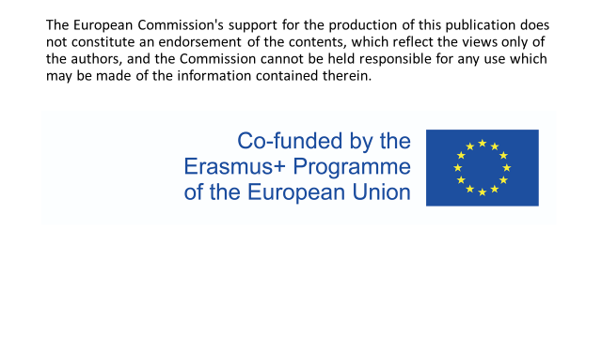

Slide 2
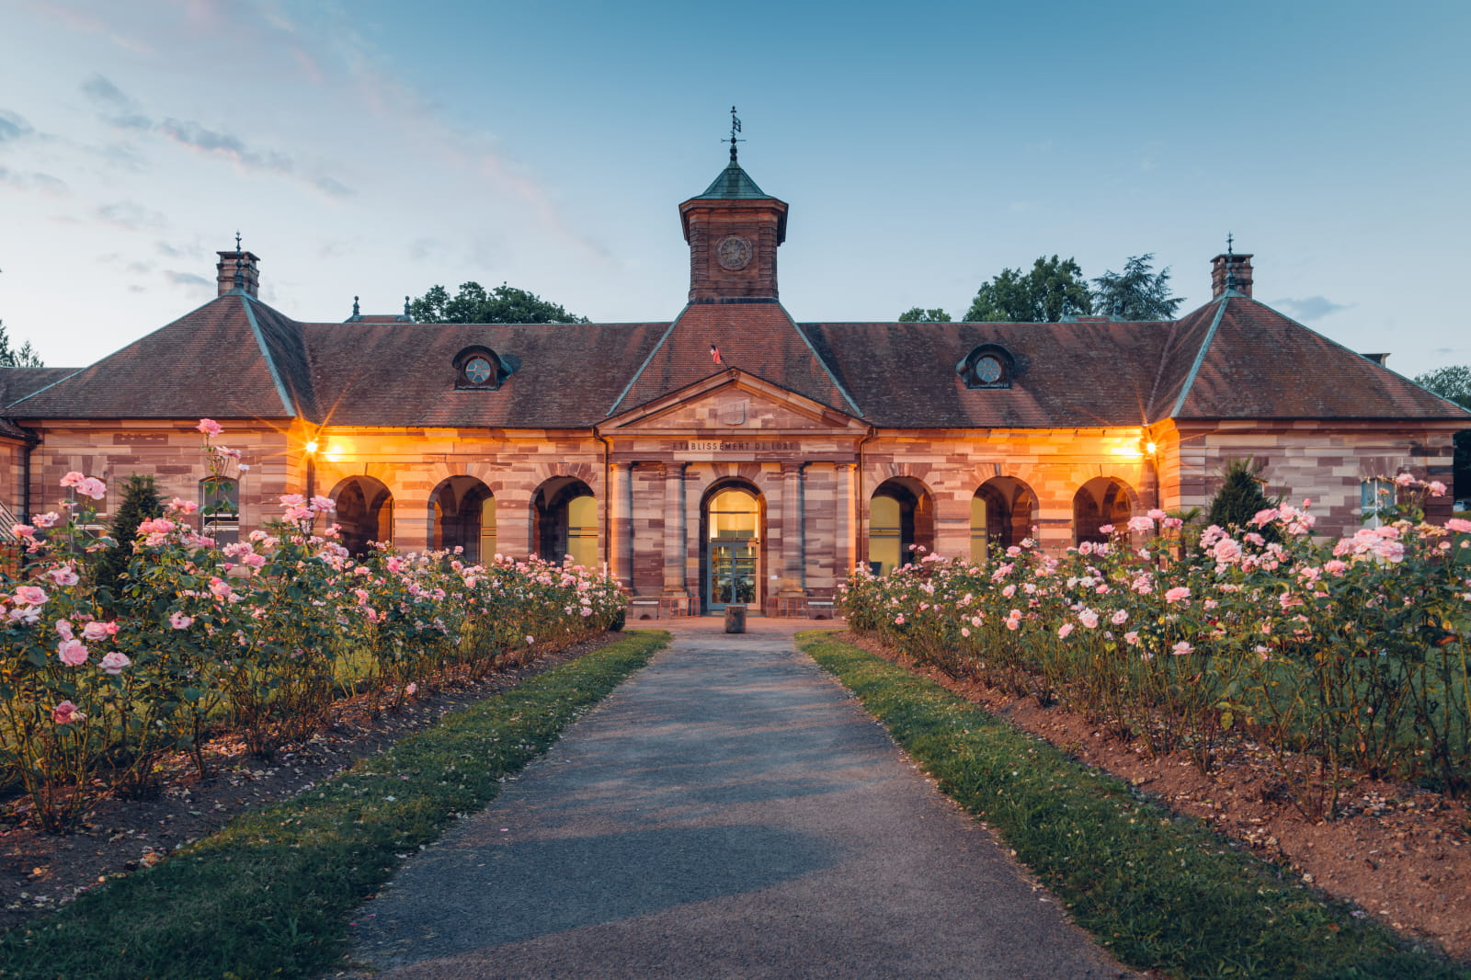
History of Luxeuil les Bains

Slide 3
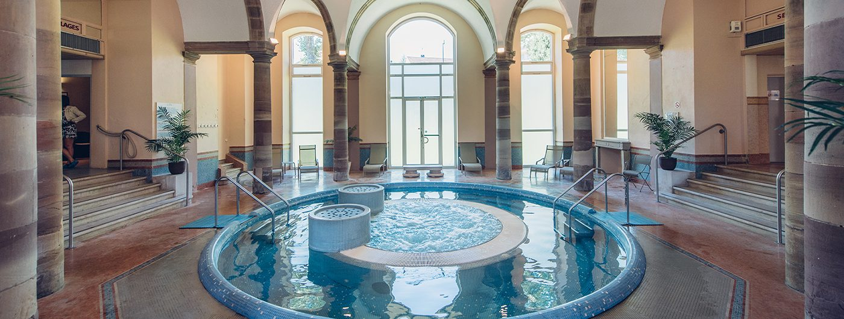
The Gallo-Roman period
Around the thermal waters. They allow the development of a craft life.

Slide 4
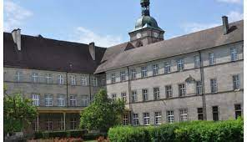
The Colomban era
In the 6th and 7th centuries, around the cloister and the abbey, St-Colomban impelled a development and a spiritual and intellectual influence well beyond the region.

Slide 5
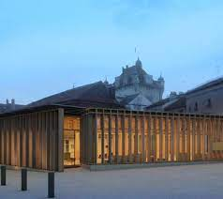
The Renaissance period
Brought the development of a rich architectural heritage.

Slide 6
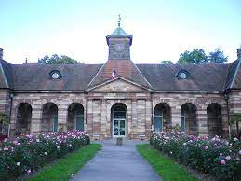
The 18th and 19th centuries
The thermal establisment is built. Thermalism develops; the reputation of Luxeuil waters is vast.

Slide 7
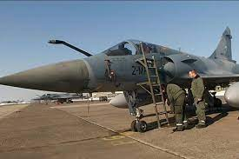
The first half of the 20th century
He construction of the Air Force Base 116 contributes to the economic development of the town.

Slide 8
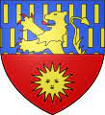
The coat of arms of the town of Luxeuil-les-Bains
The lion (on an azure background) represents the coat of arms of Franche-Comté.
The sun is an association of ideas with the Latin word LUX which means light.

Slide 9
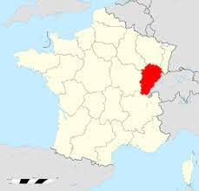
History of Franche -comté
Franche-Comté thus remained in the Holy Roman Empire, which did not prevent it from being part of the Burgundian States, or of the Spanish Empire, coming close several times to being annexed to the kingdom of France

