Slide 1
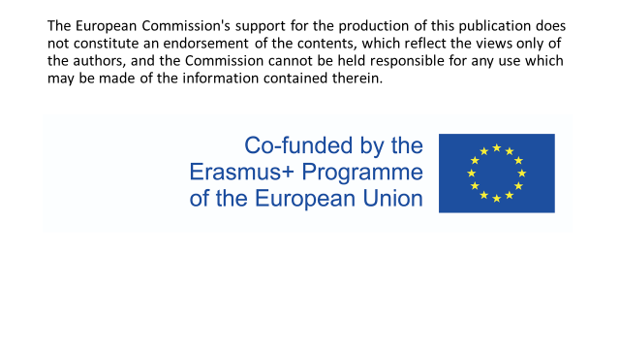

Slide 2
medications in Italy

Slide 3
Health care education in Italy
There are two different pathaways:
in order to become a DOCTOR you need a 6 years university course and then, if you want , you can get a two years or more for higher specialization
in order to become a NURSE you have to attend a three years course and then a not compulsory further specialization

Slide 4

HEALTH CARE HAS GOT A MEDICAL CENTRED APPROACH, that’s why nurses are claiming for more authonomy, because they are limited in planning activities.
Nurses play a crucial role in the safety of medicines management during transitional care. Therefore, they should be empowered and more involved in medicines management initiatives in the healthcare system. Patient safety and avoidance of medication errors during transitional care require that medicines management becomes a multidisciplinary collaboration with effective communication between healthcare providers..

Slide 5

Nurses duties
A nurse exercizes ad promotes the culture of caring and safety
While a doctor is in the «back office» ( MEDICAL PRESCRIPTIONS ARE ALWAYS NEEDED),
a nurse directly relates with the patients, keeping in touch with them in a respectful
and responsible way

Slide 6
NURSE’S TASKS
Record details and symptoms of patients’ medical history and current health
Prepare patients for exams and treatments
Administrate medications and treatments
Monitor patients for medicines’ side effects and reactions

Slide 7
NURSE’S REPONSABILITIES
Nurses' responsibility for medication administration includes ensuring that the right medication is properly drawn up in the rightt dose, and administered at the right time through the right route to the right patient. It is known as the ‘five rights’ or ‘five R’s’ of medication administration (To limit or reduce the risk of administration errors, many hospitals employ a single-dose system)

Slide 8
‘Right patient’ –This is best practiced by nurses directly asking a patient to provide his or her full name aloud, checking medical wristbands if appropriate for matching name and ID number as on a chart. It is advisable not to address patients by first name or surname alone, in the event, there are two or more patients with identical or similar names in a unit. Depending on the unit that a patient may be in, some patients, such as psychiatric patients, may not wear wristbands or may have altered mentation to the point where they are unable to identify themselves correctly. In these instances, nurses are advised to confirm a patient’s identity through alternative means with appropriate due diligence

Slide 9
Right drug’ – ensuring that the medication to be administered is identical to the drug name that was prescribed. Some brand names or generic names may have very similar spelling or sound very similar due to prefix, suffix, or starting with the same first letter. For example, beta-blocker medications all end in ‘-lol’ to aid in suggesting their mechanism of action. It is important to discern between two similarly named medications since the two drugs in question may have drastically different mechanisms of action or indications for prescribing. Recent evidence-based studies support the practice of prescribers writing out full generic names as opposed to brand names of medications along with the indication for prescribing when writing orders to help minimize confusion. Poor handwriting and abbreviations account for many medical errors due to misreading letters or numerals that appear differently to different individuals. When checking to ensure the correct medication name is printed on the product to be given to the patient, nursing staff need to remember also to check other critical information on packaging such as the expiration date and asking patients about known allergies or history of an allergic response to a drug they are about to administer, or an hypersensitivity reaction, or an expected side effect, such as nausea or diarrhea.

Slide 10
‘Right Route’ –Some common routes include oral, intramuscular, intravenous, topical, or subcutaneous injection. In modern medicine, medication administration has become more complex with the development of drugs that can be given via newer routes, including but not limited to central venous catheters, patient-controlled analgesia (PCA), epidural infusions, and intrathecal administration.
It is crucial that nurses remain educated and up to date on newer medications or less commonly administered medications to learn how they are safely delivered to patients before being asked to do so in clinical practice. Additionally, nurses must have at least a minimal basic understanding of the physiology influencing drug absorption rates and time of drug onset, as these principles relate to medication administration

Slide 11
‘
Right time’ – administering medications at a time that was intended by the prescriber. Often, certain drugs have specific intervals or window periods during which another dose should be given to maintain a therapeutic effect or level. A guiding principle of this ‘right’ is that medications should be prescribed as closely to the time as possible, and nurses should not deviate from this time by more than half an hour to avoid consequences such as altering bioavailability or other chemical mechanisms. Similarly, it is crucial that medications that are given by an infusion, such as intravenous medications, are administered at the correct rate. Failure to deliver a drug at the correct rate may lead to devastating consequences for a patient.

Slide 12
Right dose’ – Incorrect dosage, conversion of units, and incorrect substance concentration are prevalent modalities of medication administration error. This error type stems from nurses giving a patient an incorrect dose of medications, even if it is the correct medication and the patient’s identity is verified, without first checking to ensure it is the correct strength for the patient. This may be due to misplaced decimals, errors in arithmetic, or incorrect conversion between two units. For example, micrograms and milligrams may easily be mistaken with a quick, incorrect glance at unit abbreviations like mcg versus mg.
Studies that have emphasized observing positive behaviors nurses have adapted to help reduce medical errors include consulting with pharmacy personnel, using calculators to assist in arithmetic, or in some cases, cross-consulting with patients or their families about usual doses they administer at home

